Slide 1
Second-generation p-values: Introduction and Applications
Part I
Jeffrey D. Blume,
PhD
Megan H. Murray, almost PhD (July 6th defense)
and
School of Data Science
University of Virginia
Department of Biostatistics
Vanderbilt University

Slide 2
About Us
Jeffrey
Associate Dean and Professor in Data Science (UVA)
Areas of research include statistical inference, likelihood methods, second-generation p-values, prediction modeling, ROC curves, mediation modeling, missing data in prediction problems, and false discovery rates.
Website: www.statisticalevidence.com
UVA Profile: www.datascience.virginia.edu/people/jeffrey-blume
Megan
PhD Candidate in Biostatistics at Vanderbilt: July 6th Defense
Dissertation: “On second-generation p-values for equivalence testing and study planning, and flexible false discovery rate computation for classical p-values”
After graduation: Research Scientist at Eli Lilly Pharmaceuticals

Slide 3
Course Layout
Slides Part I
Introduction and applications
Coding Part I
Slides Part II
Equivalence tests, statistical properties, and false discovery rates
Coding Part II
Questions and Discussion

Slide 4
Resources
GitHub with Slides and Code
www.github.com/murraymegan/SGPV-ASA-Short-Course
RStudio Desktop
www.rstudio.com/products/rstudio/download
Interrupt or use Zoom chat for questions!
For technical difficulties email Megan
megan.c.hollister@vanderbilt.edu

Slide 5
Synopsis
Classical p-values are
Ubiquitous, Sacrosanct, Imperfect, Misused
Misunderstood (Significance vs. Hypothesis testing roles)
Openly debated in practice and theory
Trend toward estimation in reporting of results
Report a estimation interval (e.g. confidence interval)
Does interval contain only clinically significant values?
Second-generation p-values (SGPVs)
Embody and formalize this trend
Maintain and improve error rate control
Define clinically significant before looking at the data

Slide 6
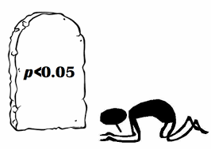
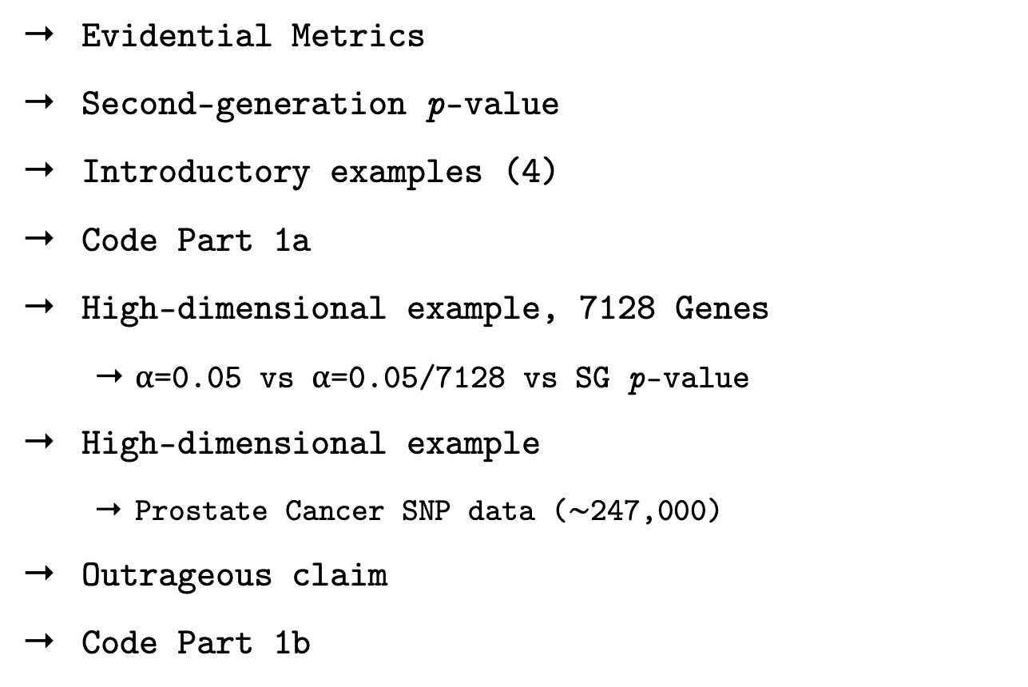
Outline
Evidential Metrics
Second-generation p-value
Introductory examples (4)
Code Part 1a
High-dimensional example, 7128 Genes
⍺=0.05 vs ⍺=0.05/7128 vs SG p-value
High-dimensional example
Prostate Cancer SNP data ($\sim$247,000)
Outrageous claim
Code Part 1b

Slide 7
Evidential metrics
Example:
Diagnostic Test
Measure of the strength evidence
Axiomatic and intuitive justification
Summary statistic, yardstick
Propensity to collect data that will yield a misleading #1
Error rates
Properties of the study design (!)
Probability that an observed #1 is misleading
False Discovery rate, False Confirmation rate
Chance that an observed result is mistaken
Properties of the observed data (!)
Positive Test
Negative Test
Sensitivity
Specificity
PPV
NPV

Slide 8
Testing
Evidential Metric | What it measures | Hypothesis Testing | Significance Testing
1 | strength of the evidence
2 | propensity for study to yield misleading evidence
3 | propensity for observed results to be misleading
Tail-area probability
(p-value)
Absent
Tail-area probability
(error rates)
Absent
misinterpret
#2
misinterpret
#1
The tail-area probability is used to measure three distinct metrics

Slide 9
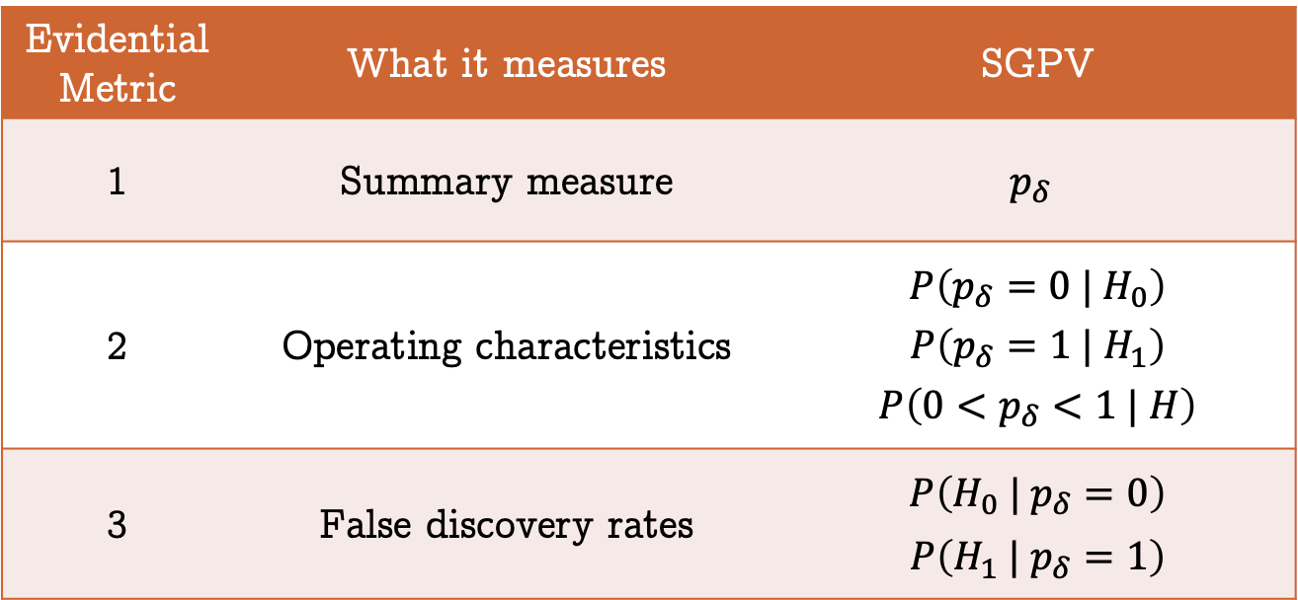
Second-generation p-value
StatisticalEvidence.com
Examine statistical properties in module 2
Retains strict error control
Evidential Metric | What it measures | SGPV
1 | Summary measure | $$p_{δ}$$
2 | Operating characteristics | $$P\left(p_{δ}=0 | H_{0}\right)$$ $$P\left(p_{δ}=1 | H_{1}\right)$$ $$P\left(0<p_{δ}<1 | H\right)$$
3 | False discovery rates | $$P\left(H_{0} | p_{δ}=0\right)$$ $$P\left(H_{1} | p_{δ}=1\right)$$

Slide 10
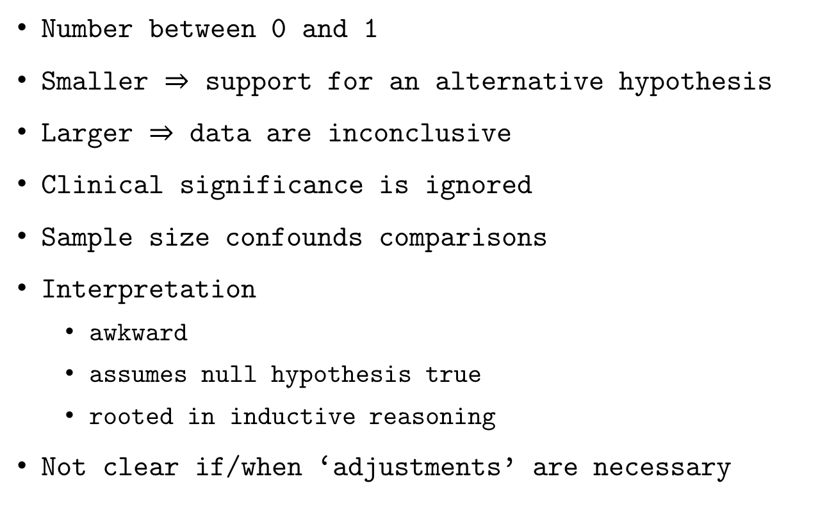
The p-value (what it is)
Number between 0 and 1
Smaller $⇒$ support for an alternative hypothesis
Larger $⇒$ data are inconclusive
Clinical significance is ignored
Sample size confounds comparisons
Interpretation
awkward
assumes null hypothesis true
rooted in inductive reasoning
Not clear if/when ‘adjustments’ are necessary
Notes:
Check transitions

Slide 11
The p-value (what it is)
2nd-generation
we want
⌃
near 0 supports alt
near 1 supports null
near ½ inconclusive
Version 2.0
Number between 0 and 1
Smaller $⇒$ support for an alternative hypothesis
Larger $⇒$ data are inconclusive
Clinical significance is ignored
Sample size confounds comparisons
Interpretation
awkward
assumes null hypothesis true
rooted in inductive reasoning
Not clear if/when ‘adjustments’ are necessary
✓
✓
support null
incorporated
✗
Fraction of data-supported
hypotheses that are null
straightforward
conditions on observed data
descriptive, summarizes
Ideally, never

Slide 12
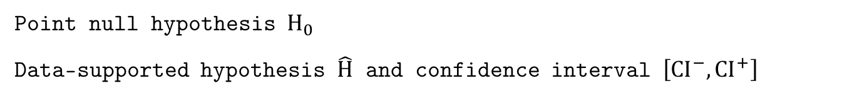
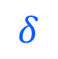
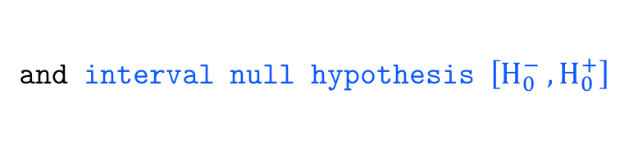
Illustration
$$δ$$
Point null hypothesis $H_{0}$
Data-supported hypothesis $\hat{H}$ and confidence interval $\left[CI^{−},CI^{+}\right]$
and interval null hypothesis $\left[H_{0}^{−} ,H_{0}^{+}\right]$

Slide 13
Illustration
Works with confidence, credible, and support intervals

Slide 14
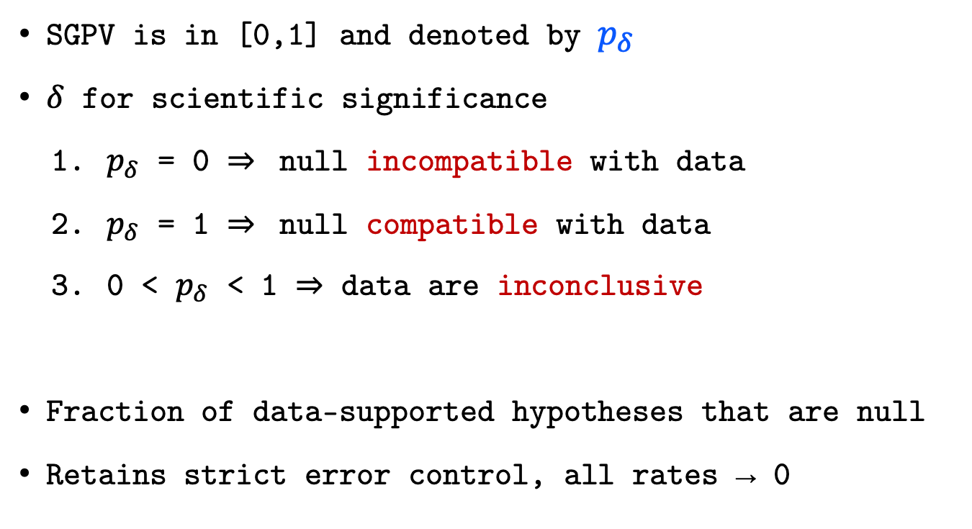
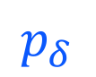
Second-generation p-value
$$p_{δ}$$
SGPV is in [0,1] and denoted by $p_{δ}$
$δ$ for scientific significance
$p_{δ}$ = 0 $⇒$ null incompatible with data
$p_{δ}$ = 1 $⇒$ null compatible with data
0 < $p_{δ}$ < 1 $⇒$ data are inconclusive
Fraction of data-supported hypotheses that are null
Retains strict error control, all rates → 0

Slide 15
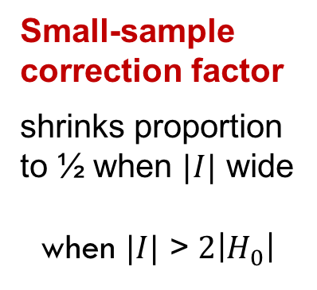
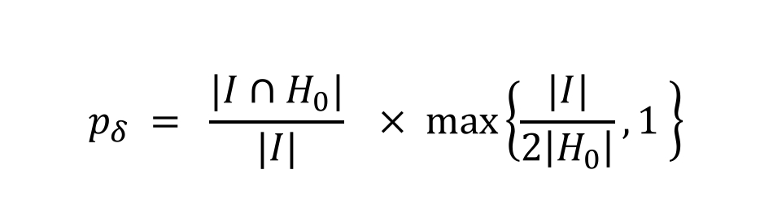
Definition
Second-generation p-value (SGPV)
$$p_{δ} = \frac{|I∩H_{0}|}{|I|}× max\left\{\frac{|I|}{2\left|H_{0}\right|},1 \right\}$$
Proportion of data-supported hypotheses that are also
null hypotheses
Small-sample correction factor
shrinks proportion to ½ when $|I|$ wide
when $|I|$ > $2\left|H_{0}\right|$

Slide 16
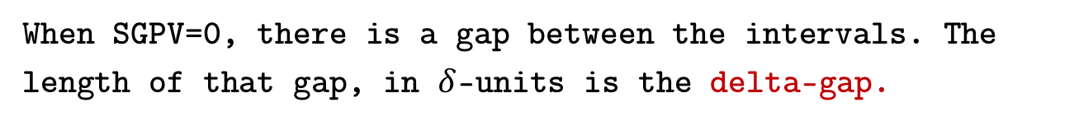
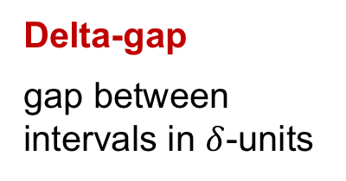
The Delta-gap
When SGPV=0, there is a gap between the intervals. The length of that gap, in $δ$-units is the delta-gap.
Delta-gap
gap between intervals in $δ$-units
Useful for ranking results when SGPV = 0

Slide 17
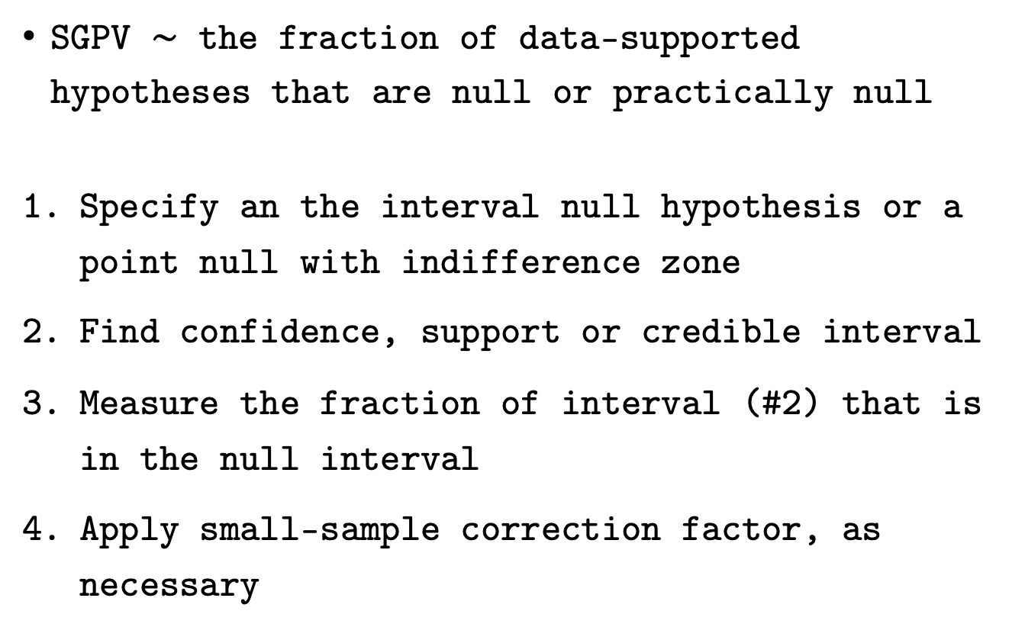
Steps
SGPV $\sim$ the fraction of data-supported hypotheses that are null or practically null
Specify an the interval null hypothesis or a point null with indifference zone
Find confidence, support or credible interval
Measure the fraction of interval (#2) that is in the null interval
Apply small-sample correction factor, as necessary

Slide 18
Systolic Blood Pressure
SBP is reported to the nearest 2 mmHg
Null Hypothesis: mean SPB is 145 mmHg
Interval Null hypothesis: mean is 143 to 147 mmHg
Results from 8 mock studies

Slide 19
p-value | Max P | 2nd Gen P
1 | 1 | 1

Slide 20
p-value | Max P | 2nd Gen P
1 | 1 | 1
0.0455 | 1 | 1

Slide 21
p-value | Max P | 2nd Gen P
1 | 1 | 1
0.0455 | 1 | 1
0.4237 | 1 | 0.7041

Slide 22
p-value | Max P | 2nd Gen P
1 | 1 | 1
0.0455 | 1 | 1
0.4237 | 1 | 0.7041
1 | 1 | 0.5

Slide 23
p-value | Max P | 2nd Gen P
1 | 1 | 1
0.0455 | 1 | 1
0.4237 | 1 | 0.7041
1 | 1 | 0.5
0.0455 | 1 | 0.5

Slide 24
p-value | Max P | 2nd Gen P
1 | 1 | 1
0.0455 | 1 | 1
0.4237 | 1 | 0.7041
1 | 1 | 0.5
0.0455 | 1 | 0.5
<0.0001 | 0.3173 | 0.2499

Slide 25
p-value | Max P | 2nd Gen P
1 | 1 | 1
0.0455 | 1 | 1
0.4237 | 1 | 0.7041
1 | 1 | 0.5
0.0455 | 1 | 0.5
<0.0001 | 0.3173 | 0.2499
<0.0001 | 0.0455 | 0

Slide 26
p-value | Max P | 2nd Gen P
1 | 1 | 1
0.0455 | 1 | 1
0.4237 | 1 | 0.7041
1 | 1 | 0.5
0.0455 | 1 | 0.5
<0.0001 | 0.3173 | 0.2499
<0.0001 | 0.0455 | 0
<0.0001 | <0.0001 | 0

Slide 27
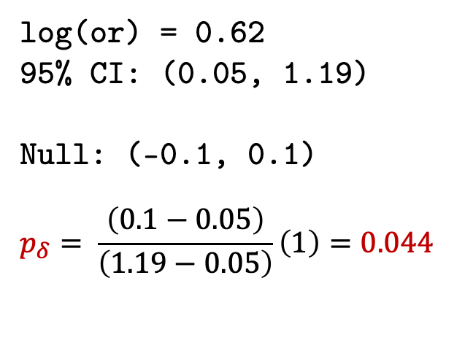
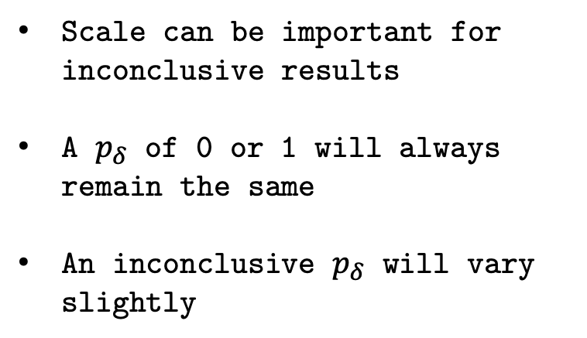
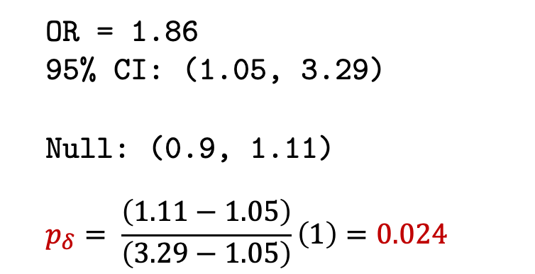
2x2 Tables & Odds Ratios
Exposure | Outcome
 | No | Yes
Exposed | 35 | 65
Unexposed | 50 | 50
OR = 1.86
95% CI: (1.05, 3.29)
Null: (0.9, 1.11)
$$p_{δ}= \frac{\left(1.11−1.05\right)}{\left(3.29−1.05\right)}\left(1\right)=0.024$$
Scale can be important for inconclusive results
A $p_{δ}$ of 0 or 1 will always remain the same
An inconclusive $p_{δ}$ will vary slightly
log(or) = 0.62
95% CI: (0.05, 1.19)
Null: (-0.1, 0.1)
$$p_{δ}= \frac{\left(0.1−0.05\right)}{\left(1.19−0.05\right)}\left(1\right)=0.044$$

Slide 28
Bone Marrow in Acute Myocardial Infarction (BOMAMI)
European Heart Journal (2011)
Randomized multicenter study
Intracoronary administration of autologous bone marrow cells (BMCs) can lead to a modest improvement in cardiac function
Aim: Evaluate the effect of BMC therapy on myocardial viability in patients with decreased left ventricular ejection fraction (LVEF) after acute myocardial infarction (AMI)
Notes:
Myocardial viability improved in 16/47 (34%) patients in the BMC group compared with 7/43 (16%) in the control group (P = 0.06).
http://eurheartj.oxfordjournals.org/content/32/14/1748 Figure 3

Slide 29
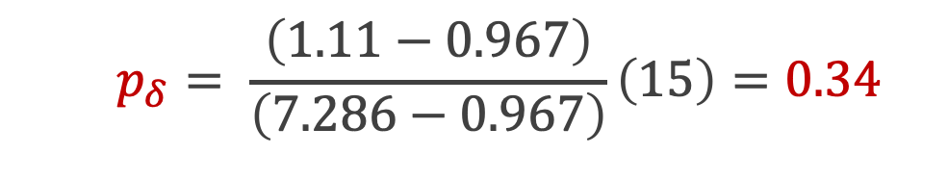
BONAMI Trial
Null Interval: (0.9, 1.11)
$$p_{δ}= \frac{\left(1.11−0.967\right)}{\left(7.286−0.967\right)}\left(15\right)=0.34$$
Notes:
Myocardial viability improved in 16/47 (34%) patients in the BMC group compared with 7/43 (16%) in the control group (P = 0.06).
http://eurheartj.oxfordjournals.org/content/32/14/1748 Figure 3

Slide 30
Effect Measures for BOMAMI
 | BMC | Control | Total
Gain | 16 | 7 | 23
No Gain | 31 | 36 | 67
Total | 47 | 43 | 90
Risk | 0.34 | 0.16
Null Hypotheses
OR/RR: (0.9, 1.11)
RD: (-0.05, 0.05)
 | Estimate | CI Lower | CI Upper | SGPV
Odds Ratio | 2.65 | 0.967 | 7.286 | 0.34
Risk Ratio | 2.09 | 0.953 | 4.589 | 0.37
Risk Difference | 0.18 | 0.003 | 0.352 | 0.24

Slide 31
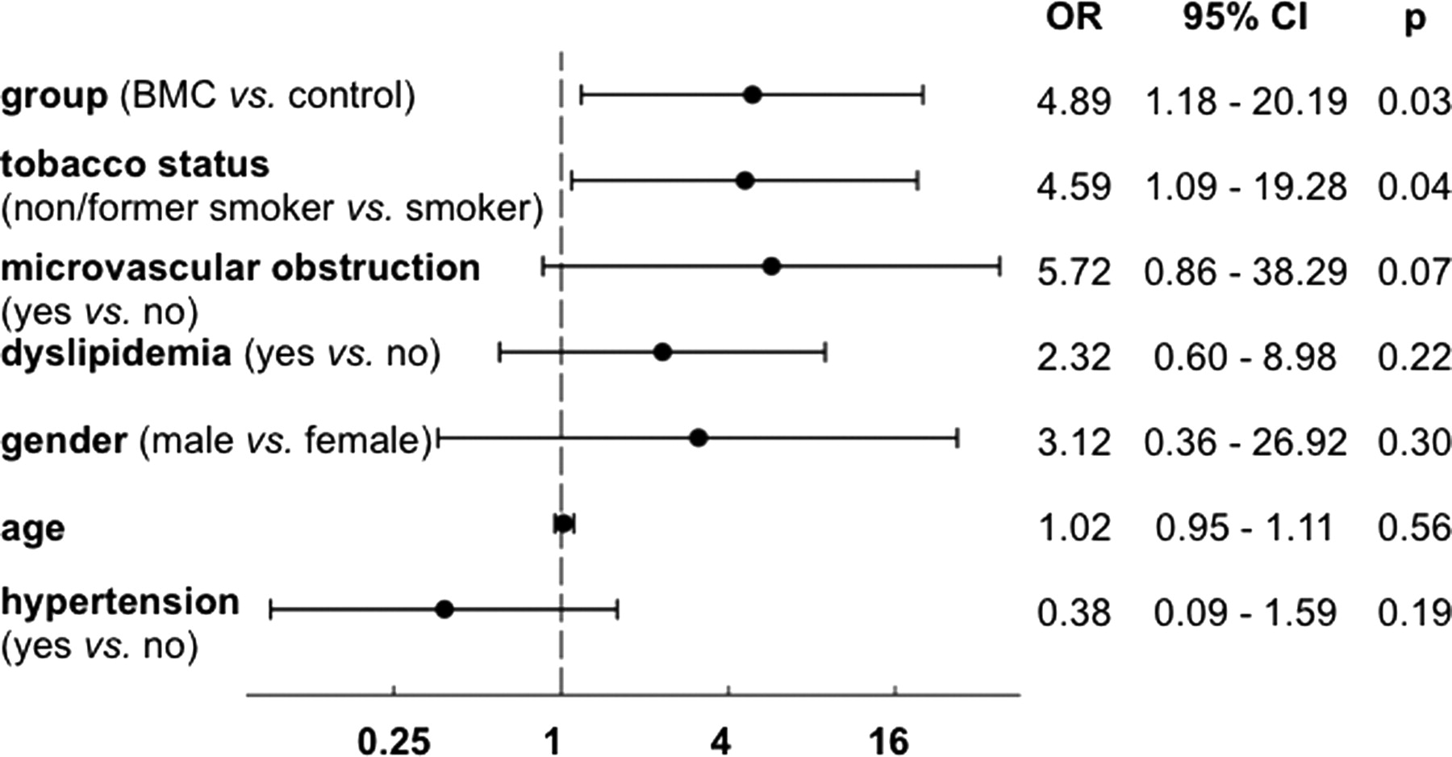
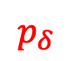
BONAMI Trial
Logistic Regression
with Null Zone: (0.9, 1.11)
$$p_{δ}$$
0
0.048
0.5
0.5
0.5
1
0.5
Notes:
Myocardial viability improved in 16/47 (34%) patients in the BMC group compared with 7/43 (16%) in the control group (P = 0.06).
http://eurheartj.oxfordjournals.org/content/32/14/1748 Figure 3

Slide 32
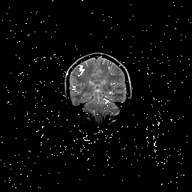
Setting interval null
Before analyzing data (!)
Measurement error
Subject matter knowledge
Impact of findings
Community standard
Get creative (fMR example)
Width not critical, buffer
The Atlantic salmon imaging saga

Slide 33
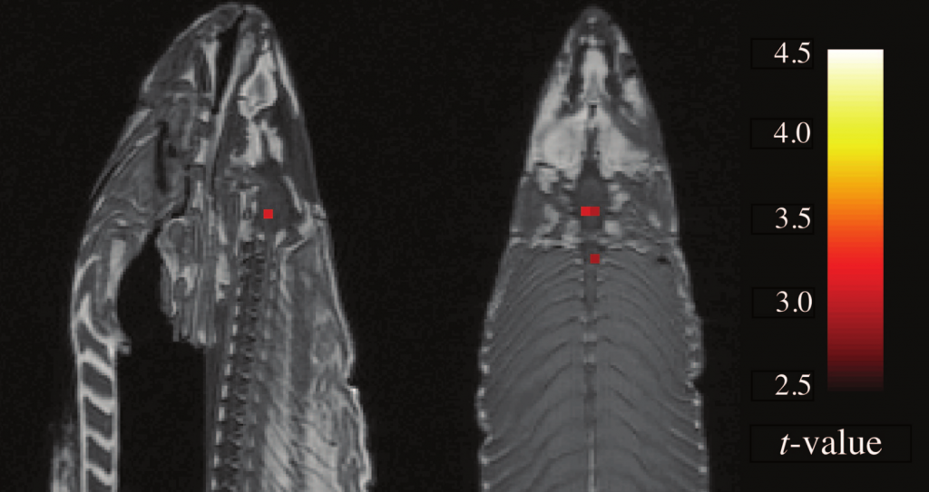
"Sagittal and axial images; t(131) > 3.15, p(uncorrected) < 0.001, 3 voxel extent threshold. Two clusters were observed in the salmon central nervous system. One cluster…in the medial brain cavity and another…in the upper spinal column."
From Bennett et. al., 2010, JSUR 1:1 1-5. 8064 total voxels; 16 identified.

Slide 35
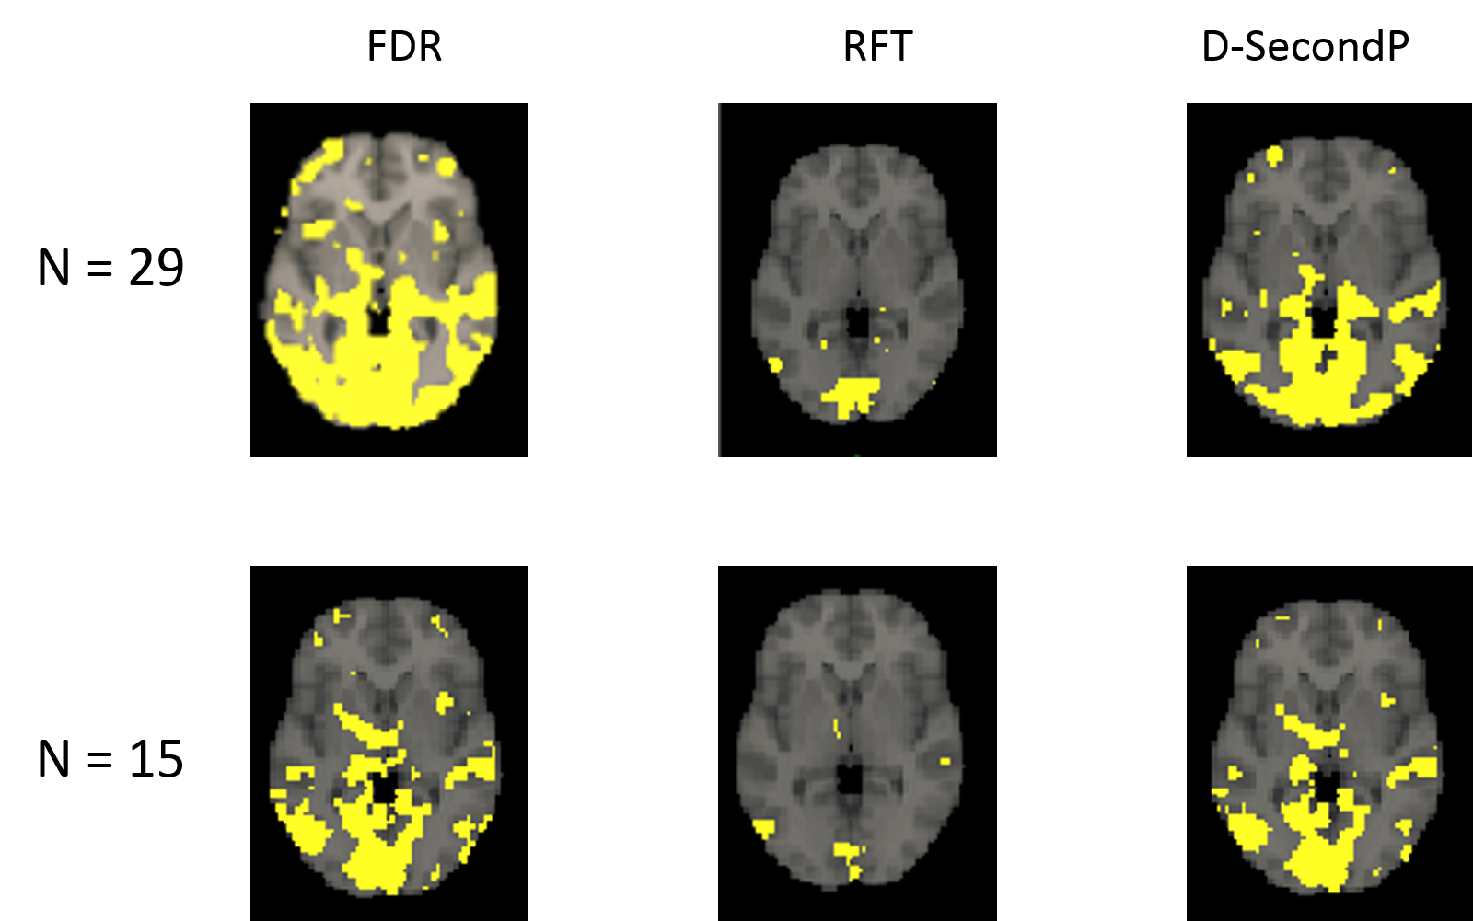
SGPVs For Functional Magnetic Resonance Imaging Data
Lisa Lin Dissertation 2021: Data decimation results of activation maps for the 37th axial slice. The yellow blobs indicate activated areas resulted from FDR (first column), RFT (second column) and D-SecondP (third column). The first row corresponds to the activation maps with full sample size at 29. The second row corresponds to the activation maps with a randomly selected sample of size 15.

Slide 36
Lung Cancer Survival
Survival time in patients with advanced lung cancer (days)
Potential for gender dissimilarities
Trial by North Central Cancer Treatment Group (1994)

Slide 37
Notes:
Logrank p-value is ~p=0.0013 I think. Discuss weighted average and what a log-rank statistic is.
What does it mean for two curves to be different?

Slide 38
Notes:
Logrank p-value is ~p=0.0013 I think. Discuss weighted average and what a log-rank statistic is.
What does it mean for two curves to be different?

Slide 39
Time for Code Part 1a!

Slide 40
High-Dimensional Data: Leukemia gene expression
Classifying acute leukemia by precursors (Golub 1999, Science)
7128 genes ; 72 patients (47 ALL and 25 AML)
Affymetrix chip collected expression levels
Goal: Identify `interesting' genes whose expression levels differ between All and AML subjects.
Looking for fold changes of 2 or more

Slide 41
7128 test-statistics

Slide 43
Notes:
10^(0.3)=2 ; so fold changes of at least 2

Slide 44
Notes:
10^(0.3)=2 ; so fold changes of at least 2

Slide 46
p-value

Slide 47
p-value

Slide 48
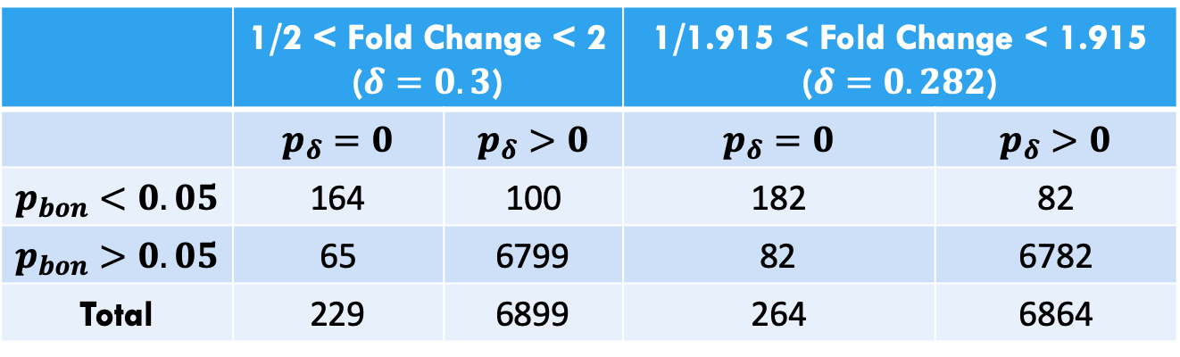
Cross-Tabulation of Leukemia Results
Bonferroni vs ASA SGPV Short Course
 | 1/2 < Fold Change < 2 ($δ=0.3$) |  | 1/1.915 < Fold Change < 1.915 ($δ=0.282$)
 | $p_{δ}=0$ | $p_{δ}>0$ | $p_{δ}=0$ | $p_{δ}>0$
$p_{bon}<0.05$ | 164 | 100 | 182 | 82
$p_{bon}>0.05$ | 65 | 6799 | 82 | 6782
Total | 229 | 6899 | 264 | 6864

Slide 49
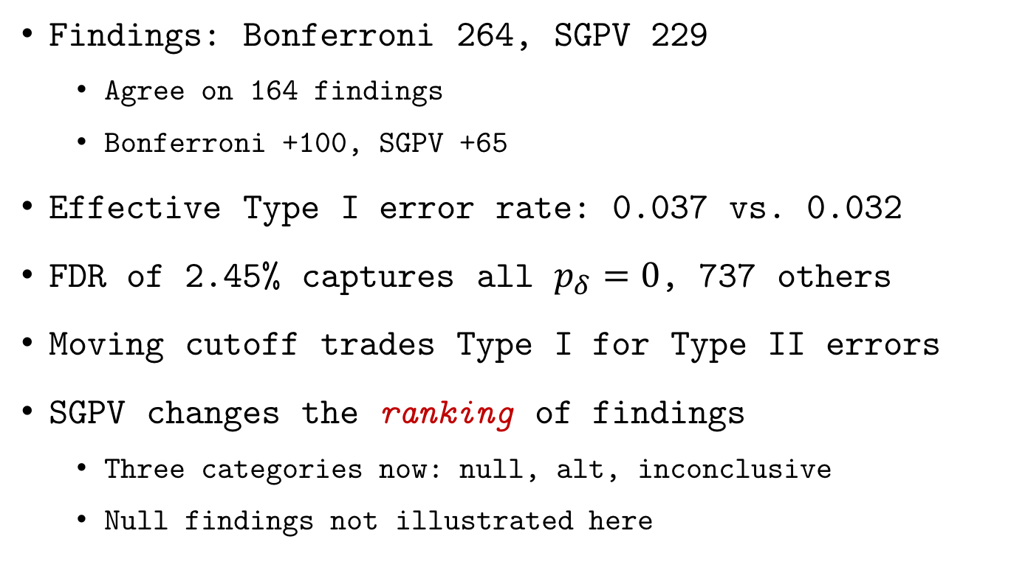
Leukemia study findings
Some SGPV findings
have a priori published validation
Findings: Bonferroni 264, SGPV 229
Agree on 164 findings
Bonferroni +100, SGPV +65
Effective Type I error rate: 0.037 vs. 0.032
FDR of 2.45% captures all $p_{δ}=0$, 737 others
Moving cutoff trades Type I for Type II errors
SGPV changes the ranking of findings
Three categories now: null, alt, inconclusive
Null findings not illustrated here

Slide 54
Prostate Cancer SNPs
International Consortium for Prostate Cancer Genetics (Schaid and Chang 2055; ICPCG 2018)
3,894 subjects: 2,511 cases & 1,383 controls
247,000 single-nucleotide polymorphisms (SNPs) from Chromosome 6
Goal: Identify `interesting’ SNPs potentially associated with prostate cancer
Looking for odds ratios of <0.9 or >1.11

Slide 55
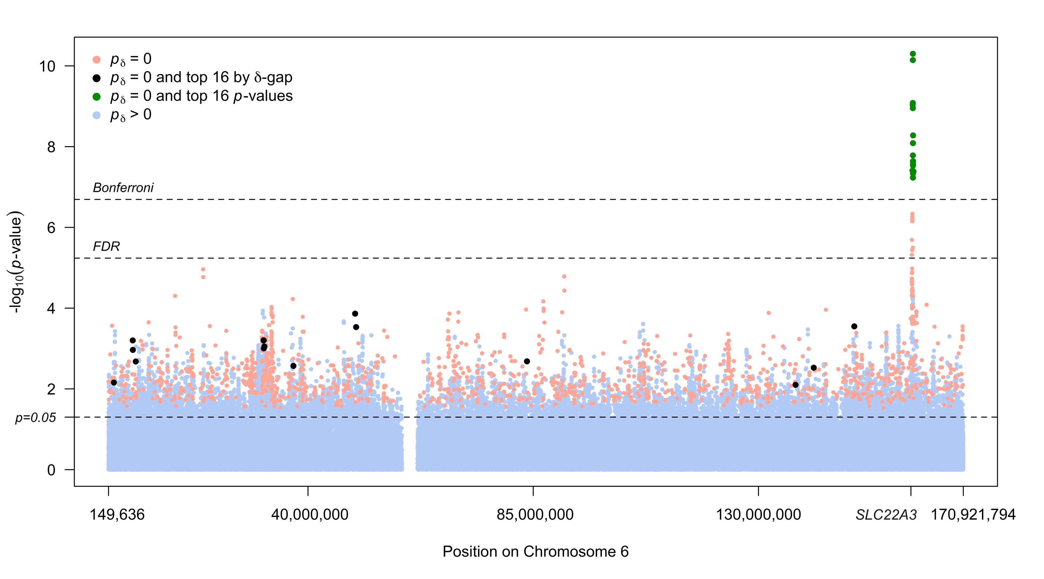
Notes:
10^(0.3)=2 ; so fold changes of at least 2

Slide 56
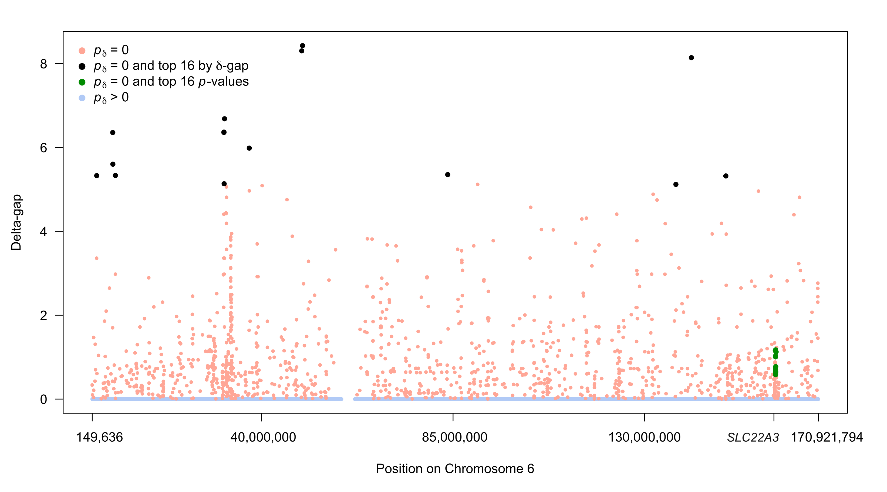
Notes:
10^(0.3)=2 ; so fold changes of at least 2

Slide 57
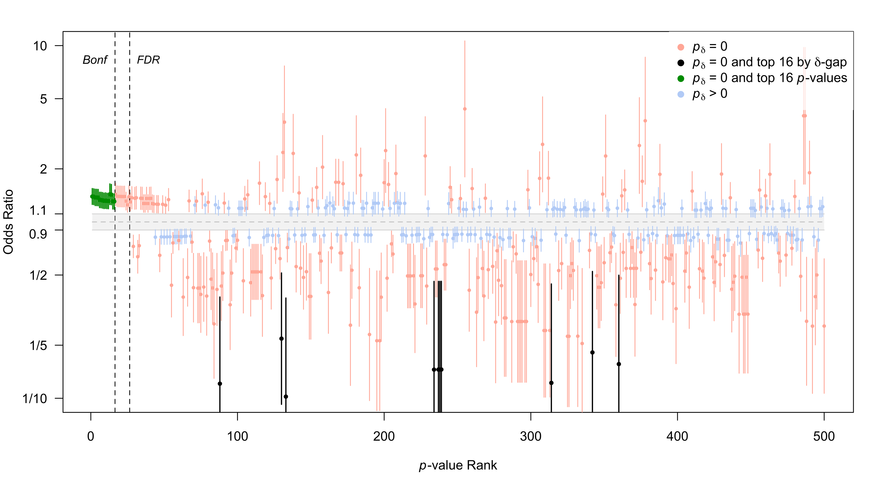

Slide 58
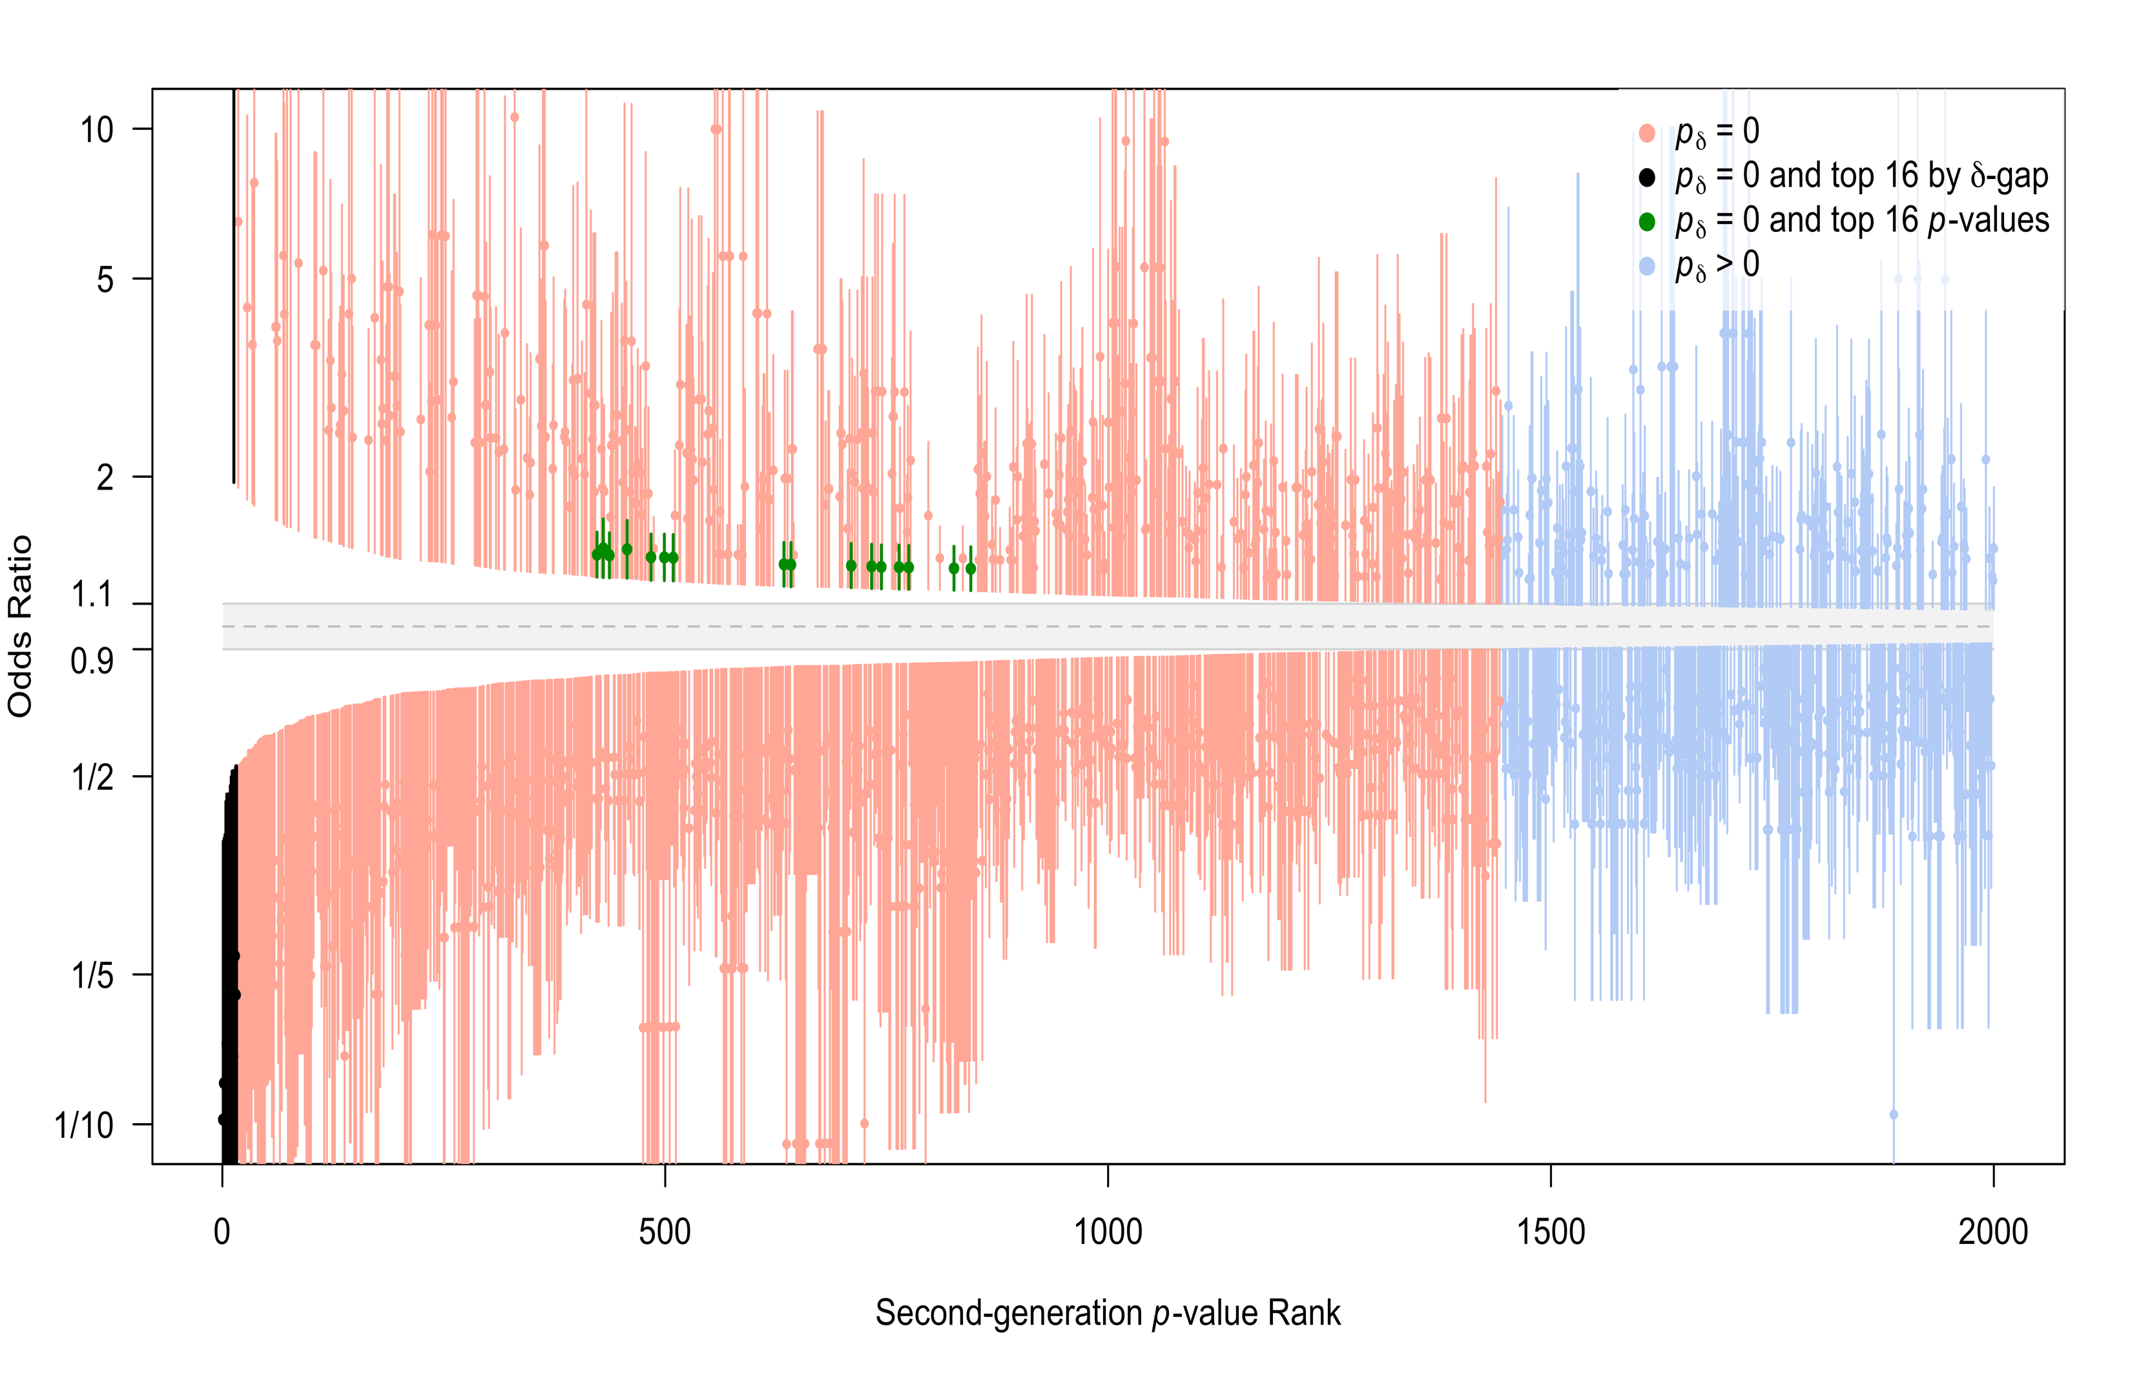

Slide 59
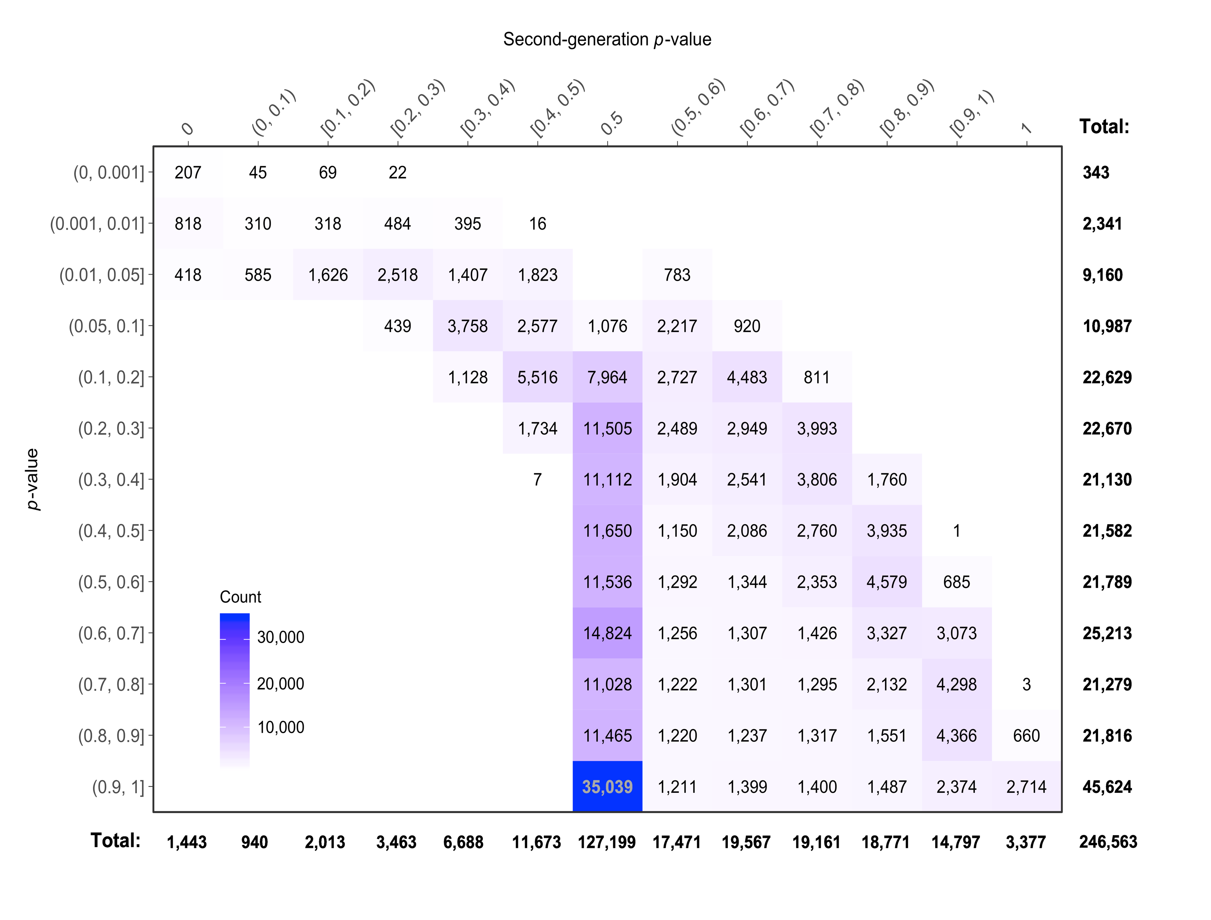
p-value

Slide 60
Outrageous Claim
SGPVs achieve the inferential properties that many scientists hope, or believe, are attributes of the classic p-value.
Discussion?

Slide 61
Time for Code Part 1b!

